Slide 1

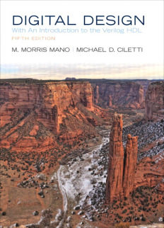
Digital Logic and Design

Slide 2


Slides can be found at
https://github.com/sajjo79/Digital-Logic-Design

Slide 3
Storage Elements: D Latch
Chapter 4: Sequential circuits

Slide 4
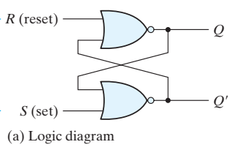
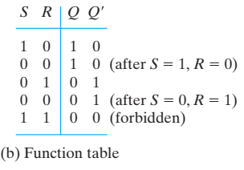
Background
NOR gates based SR Latch may have following three states:
Set State: S=1, R=0
Stable State: S=0, R=0
Reset State: S=0, R=1
Forbidden State: S=1, R=1
We want to avoid this forbidden state that introduces instability in the circuit

Slide 5
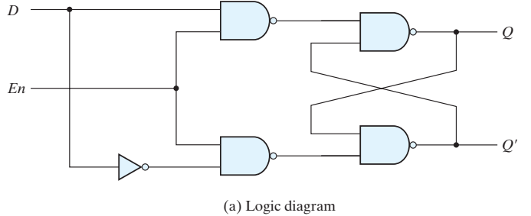
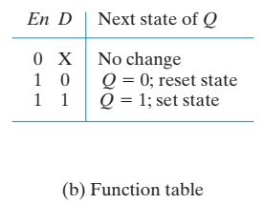
D Latch (Transparent Latch)
To eliminate the forbidden state, ensure that both S and R will not be equal to 1 at the same time
D-Latch (data latch) puts this restriction on SR Latch.
This has only two inputs D and En
D input goes to the S input
D’ input goes to R input
If En = 0: S=R=1. circuit is disabled and its state is not changeable.
If En = 1:
D=0: S=0, R=1, Circuit reaches reset state
D=1: S=1, R=0, Circuit reaches set state

Slide 6
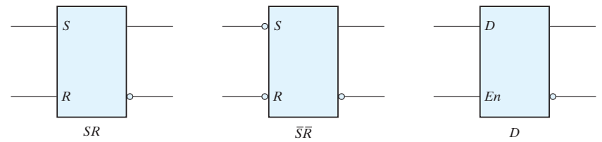
The D-Latch
It is suitable to store binary information (BI)
BI at D is transferred to Q output as shown in the table. This is why it is called transparent latch
Graphic symbols for the various latches

Slide 7
7
Thanks for watching
Dr. Sajid Iqbal
Assistant Professor
Department of Computer Science
Bahauddin Zakariya University, Multan
Allah Hafiz
Slides are available at: https://github.com/sajjo79/Digital-Logic-Design

